Slide 1


Slide 2

Objectives for this session
Prompt Copilot using tables, columns, and workbook objects
Control outputs using clear constraints and formats
Diagnose weak prompts and fix them fast
Apply repeatable prompt patterns used by analysts
Notes:
Let me tell you what I actually want you to be able to do by the end of this.
I don’t want you walking out with a list of clever prompts. Those are fragile and they stop working the moment the workbook changes.
What I do want is for you to be able to give Copilot clear, concrete instructions using things it already understands. Tables, columns, named objects. The same way you already think when you work in Excel.
We’ll talk about how to control the output too. Not just asking questions, but telling Copilot what shape the answer should take. Short, structured, formatted in a way that’s actually usable.
We’ll also spend time on what happens when a prompt doesn’t work, because that’s normal. Instead of guessing or blaming the tool, you’ll learn how to quickly see what went wrong and adjust the prompt without starting over.
And along the way, I’ll show you a handful of prompt patterns I use myself. Things that work across different datasets and problems, not demo-only tricks.
If this goes the way I want it to, Copilot should feel less like something you’re experimenting with and more like something you can reliably use when you need it.”

Slide 3


What is Copilot in Excel, really? How does it work?
Prompt Copilot using tables, columns, and workbook objects
Control outputs using clear constraints and formats
Diagnose weak prompts and fix them fast
Apply repeatable prompt patterns used by analysts
Notes:
Quick grounding point before we go further.
Copilot isn’t magic. It’s reading your workbook. Tables, columns, formulas, data types. That’s the context it works with.
It works best when you tell it exactly what to use. When you don’t, it has to guess, and guessing is where things break.
Many prompt issues in my experience aren’t AI issues. They’re context issues. Fix the context and the prompt usually fixes itself.

Slide 4
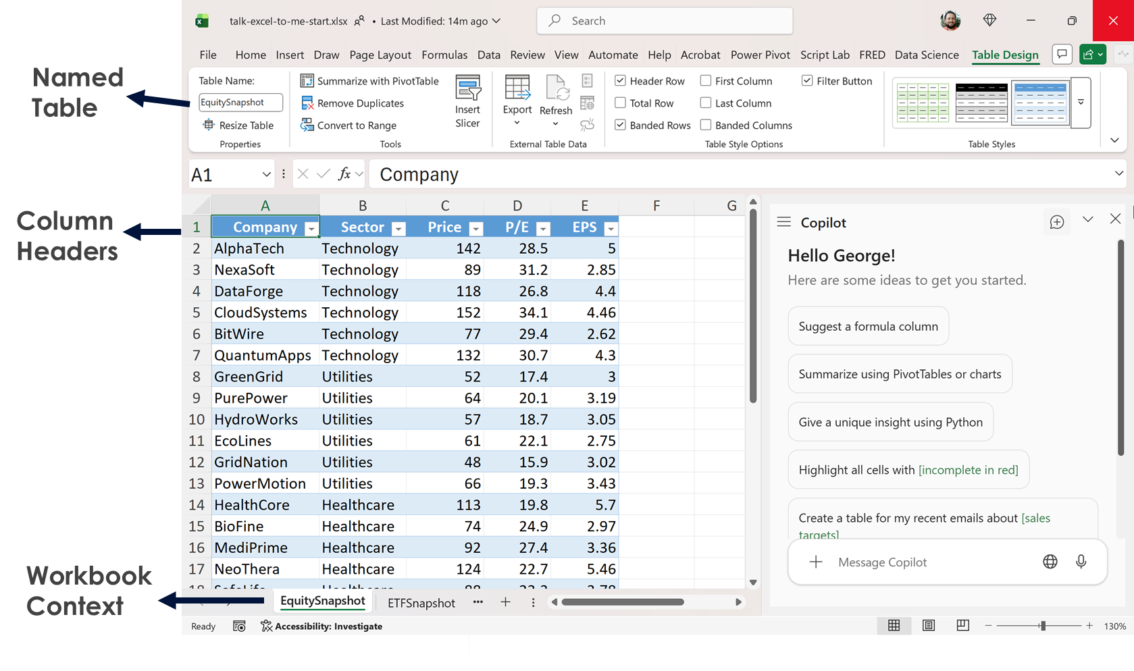
How Copilot “sees” Excel
Notes:
This is basically how Copilot sees Excel. It’s reading objects.
Named tables matter. Column headers matter. The overall workbook context matters. That’s what Copilot is reasoning over.
So when you reference a table by name, or a specific column, you’re not being overly formal. You’re giving Copilot something concrete to latch onto.
This is why vague prompts tend to fail. You’re asking it to reason without objects.
I like to say it this way: Copilot reasons over objects, not vibes.
If you give it structure, it behaves. If you give it vibes, you get vibes back.

Slide 5
Weak vs strong Excel prompt
Weak Prompt – Why It Fails
“Analyze this.”
Problems:
No table
No metric
No output format
Strong Prompt – Why It Works
“Analyze the SalesData table on the Q2 sheet. Focus on: revenue trends, top 3 outliers, and segment-level comparisons.
Deliver: 6–8 bullet points suitable for a manager update.
Use only the numeric columns.”
Named table
Clear focus
Defined output
Notes:
Let me tell you what I actually want you to be able to do by the end of this.
I don’t want you walking out with a list of clever prompts. Those are fragile and they stop working the moment the workbook changes.
What I do want is for you to be able to give Copilot clear, concrete instructions using things it already understands. Tables, columns, named objects. The same way you already think when you work in Excel.
We’ll talk about how to control the output too. Not just asking questions, but telling Copilot what shape the answer should take. Short, structured, formatted in a way that’s actually usable.
We’ll also spend time on what happens when a prompt doesn’t work, because that’s normal. Instead of guessing or blaming the tool, you’ll learn how to quickly see what went wrong and adjust the prompt without starting over.
And along the way, I’ll show you a handful of prompt patterns I use myself. Things that work across different datasets and problems, not demo-only tricks.
If this goes the way I want it to, Copilot should feel less like something you’re experimenting with and more like something you can reliably use when you need it.”

Slide 6
Prompt diagnostic framework
Goal
Context
What do you want Copilot to do in Excel?
“Check the formulas in the Profit column and tell me whether the logic is consistent.”
What data, sheet, range, or calculation does this relate to?
“The data is in Table SalesData on the sheet ‘Q2’. The Profit column uses a formula =Revenue–Cost.”
Expectations
What format or audience should Copilot aim for?
“Give the results as a bullet list with specific row numbers and suggestions.”
Source
Which data should Copilot look at?
“Use only the SalesData table and ignore the Summary sheet.”
Notes:
When a prompt doesn’t work, this is how I debug it.
I don’t argue with Copilot. I just check these four things.
First: what’s the goal? What am I actually asking it to do in Excel?
Second: what’s the context? Which data, which sheet, which calculation are we talking about?
Third: what are the expectations? Who is this for and what should the output look like?
And fourth: what’s the source? What data should it use, and just as important, what should
it ignore?
You don’t have to be poetic here. You just need all four present.
If one of these is missing, you should expect rework. That’s not Copilot being bad. That’s the prompt being incomplete.
This framework isn’t for writing perfect prompts. It’s for fixing broken ones quickly.”

Slide 7
Prompt patterns for Copilot in Excel
Zero-Shot
“Explain what this formula in cell D5 does.”
One-Shot
“Here’s how I want summaries to look:
‘Revenue grew 12% QoQ driven by…’
Now summarize Table SalesData the same way.”
Few-Shot
“Here are two examples of the style I want.
Reasoning
“Break down the steps Excel follows when evaluating this nested IF.”
Chained
“Find quality issues.”
“Now propose fixes.”
“Now rewrite formula logic cleanly.”
Negative Prompting
“Summarize this table, but do not include suggestions or next steps.”
“Now write a similar summary for the Technology sector in this table.”
Notes:
This will be covered in detail in the next several slides, we will practice together with the EquitySnapshot dataset and then you will have your try of the ETFSnapshot dataset

Slide 8
Zero-shot prompting
Fast, minimal-instruction prompting.
Good for “first draft” thinking or quick pattern-spotting.
Output is generic and often misses your intent.
Example: “Using the EquitySnapshot table, give me a brief sector-level valuation overview focusing on differences in P/E and EPS. Keep it to one short paragraph.”

Slide 9
One-shot prompting
You give one example of the tone or structure you want.
Useful for steering Copilot toward a specific voice.
Only lightly controls structure and depth.
Example: “Here’s the style I want: ‘Technology names saw higher multiples supported by strong earnings trends.’ Using the EquitySnapshot table, write a similar short summary of how valuations vary across the major sectors.”

Slide 10
Multi-shot prompting
You provide two or more examples to anchor style and framing.
Helpful when you want consistent voice and clearer structure.
Takes slightly more setup than one-shot.
Example:
  “Example A: ‘Healthcare displayed resilient earnings with mid-range valuations.’
  Example B: ‘Consumer names clustered at the lower end of the valuation range.’
  Using the EquitySnapshot table, write a sector-level valuation summary in a similar voice.”

Slide 11
Reasoning
Ask Copilot to show its steps before answering.
Useful for accuracy, transparency, and reducing hallucination.
Can produce longer, more detailed responses.
Example: “Using the EquitySnapshot table, walk through how you compare sectors based on P/E and EPS before giving the final summary. Then give me a clean, 3-bullet takeaway.”

Slide 12
Chained prompting
Split a task into clear, sequenced steps.
Ideal for complex analysis or multi-stage summaries.
More time-consuming but offers more control.
Example:
  “Scan the EquitySnapshot table and identify standout valuation patterns.”
  “Now suggest 2–3 angles to highlight.”
  “Now write the summary as three crisp bullets.”

Slide 13
Negative prompting
Tell Copilot what to avoid in the response.
Great for compliance, neutrality, and removing unwanted advice.
Requires clear boundaries to work well.
Example: “Summarize sector-level valuation patterns in the EquitySnapshot table, but keep it strictly descriptive and avoid recommendations or forward-looking statements.”

Slide 14
When to use which?
Zero-Shot
Use when you want a quick read on “what’s in here?”
Great for early exploration or gut-check summaries
One-Shot
Give one example to match tone, style, or format
Best for imitating a specific reporting voice
Few-Shot
Provide 2–4 examples to lock in consistency
Useful for standardizing team updates or recurring deliverables
Reasoning
Use when accuracy, traceability, or step-by-step logic matters
Ideal for anything that needs auditability
Chained
Break a task into deliberate steps
Great for multi-stage analysis or layered insights
Negative
Tell the model what not to do
Important for compliance, neutrality, or risk-sensitive content

Slide 15
Prompting pitfalls to avoid
Common failure modes:
Vague data references (“this”, “here”, “the data”)
Missing output constraints
Asking for judgment when you only want description
Notes:
These are the three most common ways prompts fail.
First, vague data references. Words like ‘this,’ ‘here,’ or ‘the data.’ Copilot doesn’t know what that means unless you’ve named it.
Second, missing output constraints. If you don’t tell it what the answer should look like, you’ll usually get something long, generic, or unusable.
And third, asking for judgment when you really just want description. Words like ‘evaluate’ or ‘recommend’ when all you actually need is ‘summarize’ or ‘describe.’
If you fix these three things, a lot of Copilot frustration just disappears

Slide 16

Demo: Rescue the Weak Prompt
Rewrite this prompt so Copilot can execute it cleanly on ETFSnapshot:
“Analyze this.”
Scoring rubric:
Data source named
Metric defined
Output format specified
Notes:
For this exercise, I want you to practice turning a vague, unusable prompt into something
Copilot can actually execute.
The original prompt is just: “Analyze this.”
That tells Copilot almost nothing. There’s no data context, no definition of success, and no guidance on what the output should look like.
Your job is to rewrite that prompt so it meets three criteria.
First, name the data source.
Tell Copilot exactly what it should analyze—whether that’s a table, a worksheet, or a specific column range.
Second, define the metric.
What does “analyze” actually mean here? Are we summarizing totals, calculating averages, identifying trends, or comparing categories? Be explicit.
Third, specify the output format.
Should the result be a summary table, bullet points, a chart, or a written explanation? Copilot needs to know what “done” looks like.
If you hit all three—data source, metric, and output format—you’ve transformed a useless prompt into a clear set of instructions. That’s the difference between hoping Copilot guesses correctly and actually controlling the result.
This is the core pattern we’ll reuse throughout the session.

Slide 17
Demo: Compliance-Safe Commentary
Write a strictly descriptive summary:
No recommendations
No forecasting
No opinions
Then tighten the output to 3 bullets for a risk committee.
Notes:
For this exercise, I want you to practice turning a vague, unusable prompt into something
Copilot can actually execute.
The original prompt is just: “Analyze this.”
That tells Copilot almost nothing. There’s no data context, no definition of success, and no guidance on what the output should look like.
Your job is to rewrite that prompt so it meets three criteria.
First, name the data source.
Tell Copilot exactly what it should analyze—whether that’s a table, a worksheet, or a specific column range.
Second, define the metric.
What does “analyze” actually mean here? Are we summarizing totals, calculating averages, identifying trends, or comparing categories? Be explicit.
Third, specify the output format.
Should the result be a summary table, bullet points, a chart, or a written explanation? Copilot needs to know what “done” looks like.
If you hit all three—data source, metric, and output format—you’ve transformed a useless prompt into a clear set of instructions. That’s the difference between hoping Copilot guesses correctly and actually controlling the result.
This is the core pattern we’ll reuse throughout the session.

Slide 18
The five prompt upgrades that matter the most
Name the table/data source
Specify the metric
Choose the format
Tell Copilot the audience
Iterate with intent
Notes:
This is the repeatable pattern I want you to take away.
First, name the table or data source so Copilot knows exactly what it’s working with.
Second, specify the metric—don’t say “analyze,” say what to calculate or summarize.
Third, choose the format, because output shape matters as much as the math.
Fourth, tell Copilot the audience, which controls tone, depth, and vocabulary.
And finally, iterate with intent. Don’t just rerun the prompt—adjust one thing at a time so you stay in control of the result.
If you follow this sequence, Copilot stops feeling unpredictable and starts acting like a junior analyst you can actually direct.

Slide 19



Questions?

Slide 20
Thank you

